Slide 1
Building a Plan
Instructor: Mike O’Dell
Several of the slides in this module are a modification and amplification of slides prepared by Mr. Tom Rethard for use in a prior Senior Design Class. They were originally for use with A Discipline for Software Engineering (Watts S. Humphrey), sponsored by the U.S. Department of Defense. Original slides are copyright SEI; modifications are Copyright © 2002, T. Rethard. Further modifications by Mike O’Dell. All Rights Reserved.

Slide 2
Why Plan?
A plan helps you focus on the goal
  “Begin with the end in mind.¹”
A plan let’s you estimate job completion
A plan helps you track progress
A plan gives you milestones that provide a sense of accomplishment along the way
A plan helps you identify problems early
A plan establishes commitments for the team and each individual on it
¹ Stephen R. Covey, The Seven Habits of Highly Effective People
CSE 4316

Slide 3
What is a Plan?
An agreement by the team on the cost and schedule for a specified job
A structure for organizing the work
A framework for obtaining the required resources (people, funds, etc.)
A record of what was initially committed
It’s a CONTRACT!
CSE 4316

Slide 4
Components of a Plan
A Lifecycle Planning Model: The Master Plan for the Project
  Order and criteria for key events
  Correct model for the job?
Work Estimate
  How big is the job (size and effort)?
  How long will it take, when will we finish?
Scheduling
  When do we expect to have things done?
  What are we committing to?
CSE 4316

Slide 5
Selecting the Correct Model
Discussion: Case Study 7.1 – Ineffective Lifecycle Model Selection
  Why was the model selected?
  What went wrong?
  What was the result?
  What might have been done differently?
CSE 4316

Slide 6
Representative Lifecycle Models
Pure Waterfall (the old granddaddy)
Code-and-Fix (and plan to fail)
Spiral (new age sophistication)
Modified Waterfalls (making the best of an old standby)
Evolutionary/Rapid Prototyping (design as you go)
Staged Models (show as you go)
  Design to schedule
Hybrids – some combination of above
CSE 4316

Slide 7
Pure Waterfall
Phased deliverables
Document-driven
Discontinuous, inflexible phases
All planning is done up front
Good for:
    Well-defined, complex projects
    Quality dominates cost and schedule
Not so good for:
    Projects where details cannot be completely specified up front
    Rapid development projects
CSE 4316

Slide 8
Pure Waterfall
Concept
& Planning
Fail
Pass
Requirements
Analysis
Fail
Pass
Architectural
Design
Fail
Pass
Detailed
Design
Fail
Pass
Implementation
& Debugging
Fail
Pass
System
Validation
CSE 4316

Slide 9
Build (Code)-and-Fix
In general, don’t do it!
Process: Specify it, code-and-fix it, ship it(?)
Advantages:
  Low/no overhead (no planning, documentation, standards, etc.)
  You can start TODAY!
  Requires little other than technical expertise
Disadvantages:
  No means of assessing progress, problems
  Dangerous! for other than tiny projects
CSE 4316

Slide 10
Spiral
Risk-oriented, layered approach
Process:
  Break project into mini-projects, each addressing major risks, e.g.
    Risk of poor specifications
    Risk of poorly understood architecture
  Iterate until risks are eliminated
    Six steps in each iteration
Advantages:
  Time and money can reduce risk
Disadvantages
  Complex
CSE 4316

Slide 11
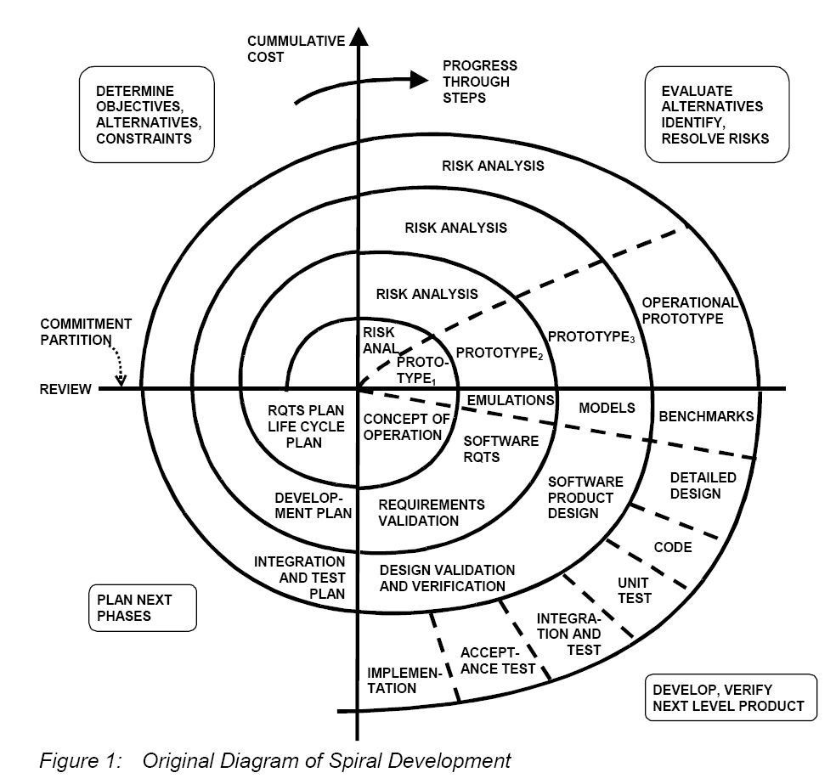
Spiral
Start
CSE 4316
(Diagram from “Spiral Development: Experience, Principles and Refinements”, workshop paper by Barry Boehm)

Slide 12
Modified Waterfalls
Waterfall with Overlapping Phases (Sashimi)
  Like pure waterfall, but phases can overlap
Concept
& Planning
Requirements
Analysis
Architectural
Design
Detailed
Design
Implementation
& Debugging
System
Validation
CSE 4316

Slide 13
Modified Waterfalls
Waterfall with Subprojects
  Begin detailed design on subprojects before overall architectural design is complete
Concept
& Planning
Requirements
Analysis
Architectural
Design
Detailed
Design
Implementation
& Debugging
Detailed
Design
SubSystem
Validation
Detailed
Design
Implementation
& Debugging
Detailed
Design
Implementation
& Debugging
SubSystem
Validation
Implementation
& Debugging
SubSystem
Validation
System
Validation
SubSystem
Validation
CSE 4316

Slide 14
Modified Waterfalls
Concept
& Planning
Waterfall with Risk Reduction
  Spiral for requirements and architectural design phases
Requirements
Analysis
Architectural
Design
Detailed
Design
Generally, only for very large and complex projects
Implementation
& Debugging
System
Validation
CSE 4316

Slide 15
Evolutionary (or Rapid) Prototyping
Especially useful when requirements are changing rapidly, or cannot be committed
Process:
  Design initial prototype of external/prominent aspects
  Review with customer
  Iterate and refine until “good enough”
Advantages
    Keeps customer involved in process
    Low overhead
Disadvantages
    Impossible to project schedule/budget
    Can evolve to code-and-fix
CSE 4316

Slide 16
Staged Delivery Models
Follow architectural design with staged design, implementation, test and delivery
  Staged delivery: iterate until done
  Design-to-schedule: iterate until scheduled time
  Evolutionary delivery: Iterate with customer feedback until done (Beta test approach)
CSE 4316

Slide 17
Hybrid Staged Delivery Model
Concept
& Planning
Design-to-Schedule with risk reduction
(our model, approx.)
Requirements
Analysis
Architectural
Design
High Priority: Detailed design, implement and test
Medium High Priority: Detailed design, implement and test
Release
Medium Priority: Detailed design, implement and test
Run out of time and money
Medium Low Priority: Detailed design, implement and test
Low Priority: Detailed design, implement and test
CSE 4316

Slide 18
Choosing the Right Model
Strengths and weaknesses analysis
  Discussion: Table 7-1
Case Study 7-2: Effective Lifecycle Model Selection
  Project characteristics
  Why was the model the right one?
  What was the outcome?
CSE 4316

Slide 19
Tools/Techniques to Help You
PERT and CPM Tools
  Program (or Project) Evaluation and Review Technique
  Critical Path Method (from Dupont)
  Account for task dependencies
  Generally applies 3 separate estimates for each task (shortest, nominal and longest) to calculate the expected effort
    Identify longest/critical path(s)
CSE 4316

Slide 20
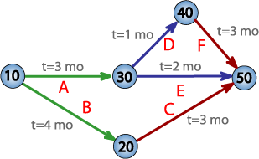
Tools/Techniques to Help You (PERT Chart)
CSE 4316

Slide 21
Tools/Techniques to Help You
CoCoMo (Constructive Cost Model)
  Estimating tool created by Barry Boehm (Software Engineering Economics, 1981)
  Based on size, complexity, environment, team composition, language, tools, etc.
  Method is based on a large study of varying size significant projects.
CSE 4316

Slide 22
Work Breakdown Structure
Breaks down the work to be done into specific, product-oriented manageable units
Allows development of a detailed plan
  Basis for project cost and schedule
Enables assignment of responsibility
  Provides basis for accountability of individuals
Defines independent work units – minimum interfacing with or dependency on other work units
Allows measurement of progress
CSE 4316

Slide 23
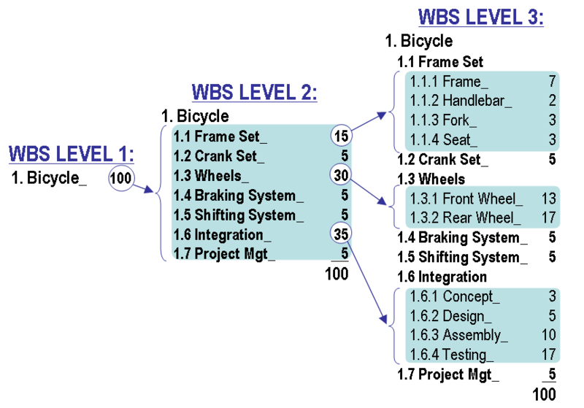
Work Breakdown Structure
WBS: Building a Bicycle
CSE 4316

Slide 24
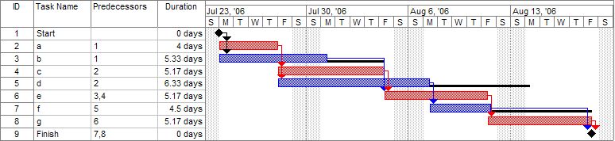
Milestone Tracking - GANTT
GANTT Chart Display Using MS Project
See Sample MS Project file on website.
CSE 4316

Slide 25
High Quality Plans
Characteristics, as stated in the SEI text
  Complete
  Readily accessible, even by the customer
  Clear
  Specific
  Precise
  Accurate
Not in the SEI text, but necessary
  MEASURABLE
CSE 4316

Slide 26
What’s makes a Good Plan?
Complete Product Specifications
A clear Statement of Work
  Size estimate and schedule
Schedule for critical Milestones
A complete Work Breakdown Structure
The Processes/Procedures that you will follow
Identification of your Stakeholders
SRD…ADS/DDS
PROJECT
CHARTER
MS PROJECT
PLAN
PROJECT
CHARTER
CSE 4316

Slide 27
What’s makes a Good Plan?
From the customer’s perspective:
  Your commitment to deliver what is specified
  The quality level of the product
  A mechanism for participation/cooperation
Integrity and Openness
CSE 4316

Slide 28
Product Specifications
Provide the details of what will be done:
  Requirements (SRD)
  Architecture (ADS)
  Detailed Design Documentation (more of the how at this stage)
Provides the basis for system testing and acceptance
CSE 4316

Slide 29
Statement of Work
A narrative description of the work that is to be done:
  Details of hardware and software components
  Description of deliverables
  Estimate of start and stop dates for key phases of process
  Acceptance criteria
CSE 4316

Slide 30
Milestones
Driven by the lifecycle model you use
  Establishes start and stop dates for all key phases of project
  Reinforced by your detailed schedules
  Use PERT/GANTT
Provides basis for measurement of progress
  Earned Value
Provides basis for identifying and estimating risks
Specifies critical deliverables
  ALL milestones have deliverables!
CSE 4316

Slide 31
Processes/Procedures
Defines how things will get done
  Provides the basis for establishing critical milestones and deliverables
  Establishes entry and exit criteria for critical phases
  Establishes the standards that will be used
  Defines the tools that are required to complete the work
CSE 4316

Slide 32
Stakeholders
Any person or organization that has a vested interest in the success of you project
  Your customer or sponsor
  Your company
  Your company’s owners/stockholders
  Your management
CSE 4316

Slide 33
Plan Documentation and Tracking
System Requirements Document
  WHAT you plan to create
Project Charter
  HOW you will go about the process of creating the WHAT
  Includes RISK MANAGEMENT plan
Work Breakdown Structure/GANTT
  The specific STEPS you will take, WHEN things must be done, and WHO will do them
  MS Project
CSE 4316

Slide 34
What is a Systems Requirements Document (SRD)?
A detailed description of the features and functions of a product, incorporating:
  End-user and sponsor input
  Developer input
  Management input
  Standards and processes
Your documented commitment to deliver
Your contract with your stakeholders that identifies WHAT you will create
(See SRD template and SRDs from prior teams on class website.)
CSE 4316

Slide 35
What is a Project Charter?
A document that summarizes the project
  Defines the scope and objectives of the project
  Delineates organizational relationships
  Delineates individual authority and responsibility
  Identifies key risks and plan to handle them
  Specifies dependencies on other organizations
  Describes the specific functions to be performed
  Lays out the master schedule for the project
  Documents cost and time estimates
  Document person-loading requirements/schedule
  Documents management approval of the details of the project
(See Charter template and Charters from prior teams on class website.)
CSE 4316

